Slide 1

Machine Learning Introduction
By Amrita Panjwani

Slide 2

Data
Immeasurable amount of data is being collected
To get an estimate: 2.5 quintillion bytes of data is generated per day!
For example:
5.5 billion google searches are done daily
5.9 billion videos are watched daily on YouTube
223 million emails are sent daily
And so on…

Slide 3


With the availability of so much data it is finally possible to use it to build models that can help us in predictions (predictive models)
And also complex data can be analyzed from different lenses to get better insights and deliver accurate results.

Slide 4

Example:
Tagging on facebook

Slide 5

Netflix recommendations

Slide 6

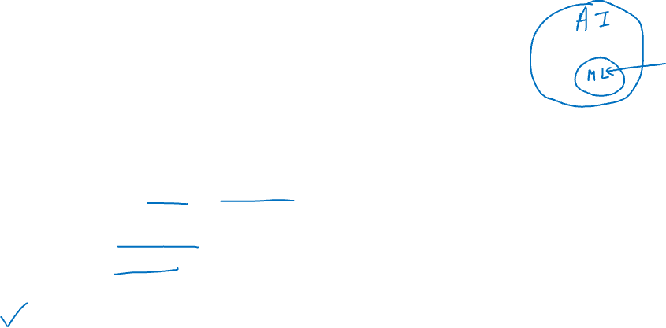
So lets define Machine Learning…
In simple words , machine learning is a process of “helping the machine learn how to take decisions logically.”
It makes use of data and algorithms to learn
And then it is retrained on similar data to improve its accuracy
Machine learning is a part of Artificial Intelligence

Slide 7
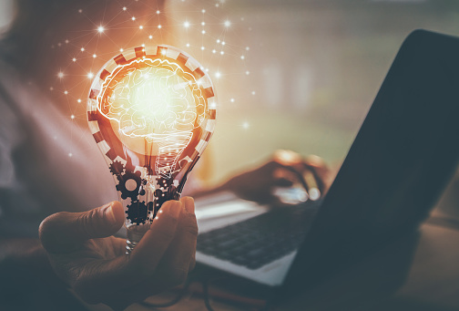

Companies such as Netflix & Amazon build such Machine Learning models by using tons of data in order to identify profitable opportunities and avoid unwanted risks.

Slide 8
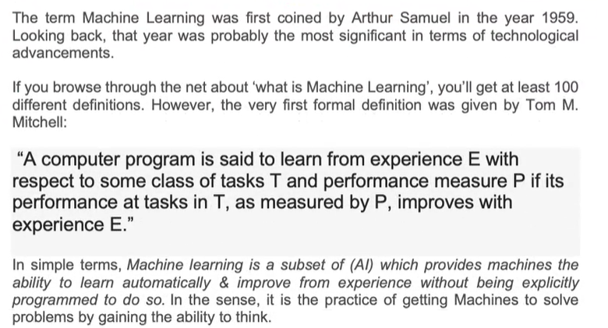
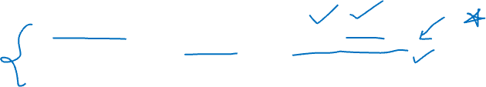

Slide 9
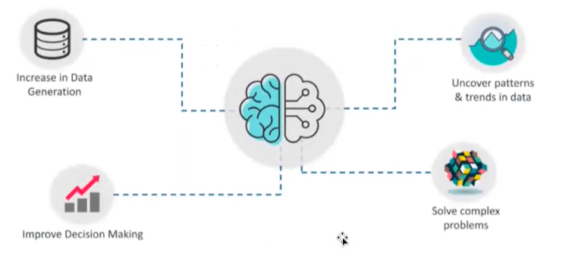

Why Machine Learning ?

Slide 10
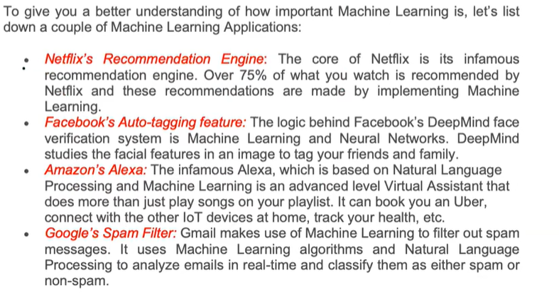


Slide 11
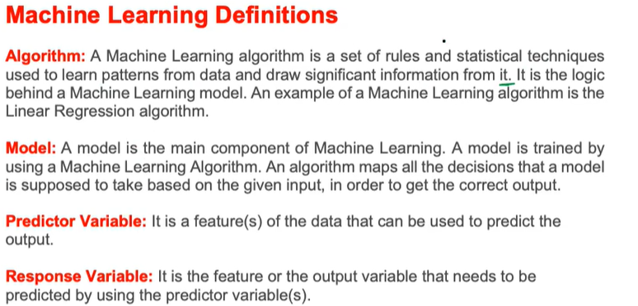
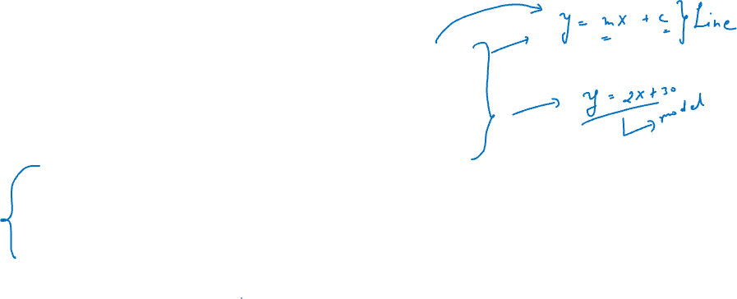

Slide 12
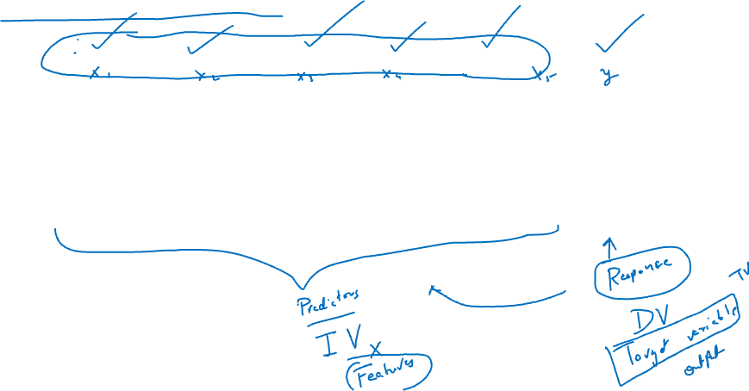
House Price Example
No. of rooms | Locality | Carpet area | Location | No. of Balconies | House price
-- | -- | -- | -- | -- | --
-- | -- | -- | -- | -- | --
-- | -- | -- | -- | -- | --
-- | -- | -- | -- | -- | --
-- | -- | -- | -- | -- | --

Slide 13
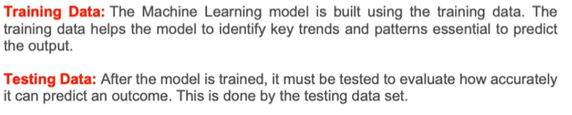

Slide 14
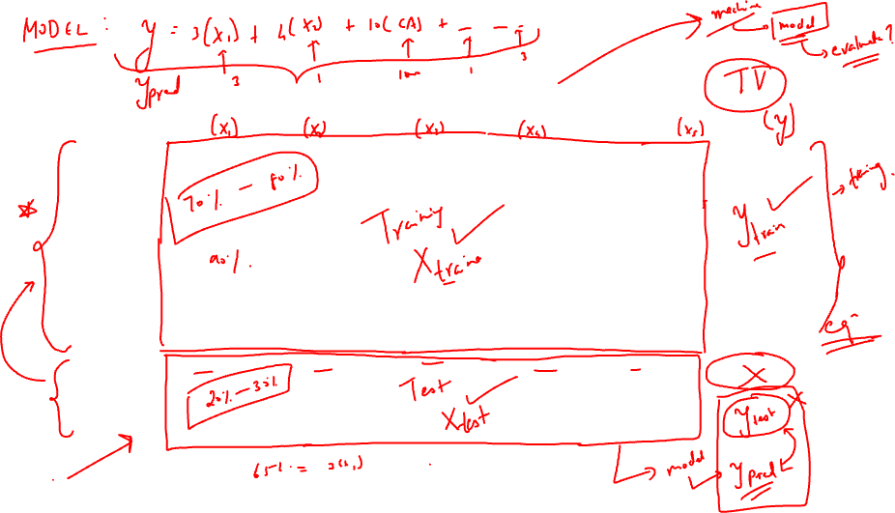
S.No. | No. of rooms | Locality | Carpet area | Location | No. of Balconies | House price
1 | -- | -- | -- | -- | -- | --
2 | -- | -- | -- | -- | -- | --
3 | -- | -- | -- | -- | -- | --
4 | -- | -- | -- | -- | -- | --
5 | -- | -- | -- | -- | -- | --
6 | -- | -- | -- | -- | -- | --
7 | -- | -- | -- | -- | -- | --
8 | -- | -- | -- | -- | -- | --
9 | -- | -- | -- | -- | -- | --
10 | -- | -- | -- | -- | -- | --

Slide 15
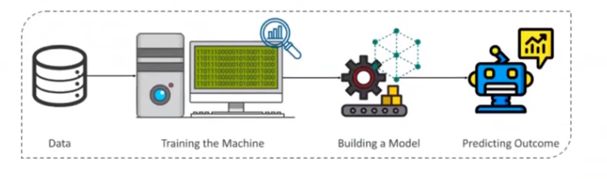
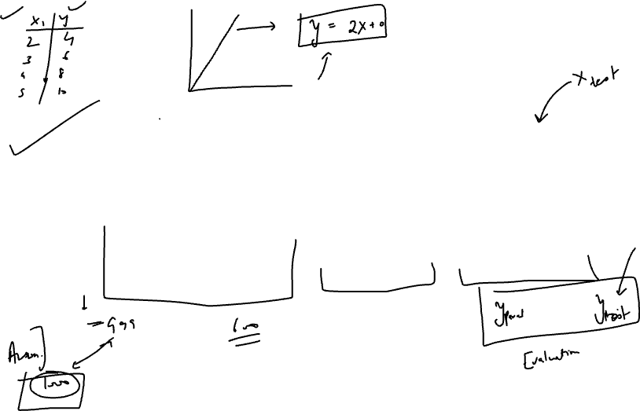

Slide 16
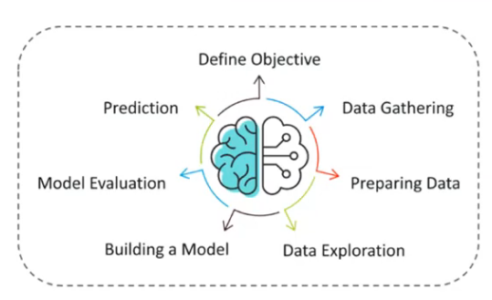
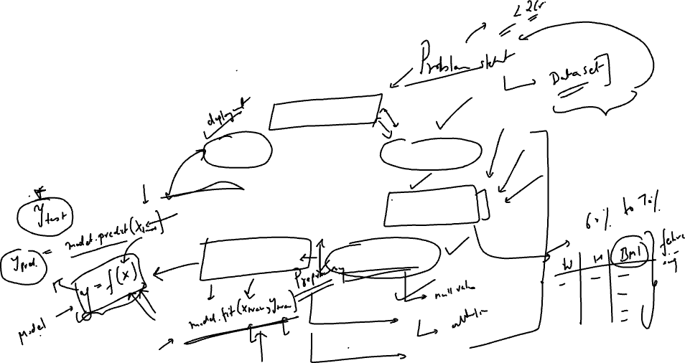
Steps in machine Learning

Slide 17
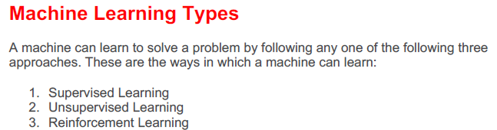


Slide 18
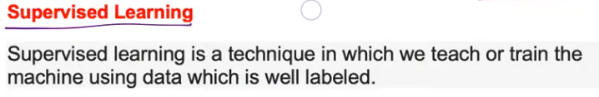
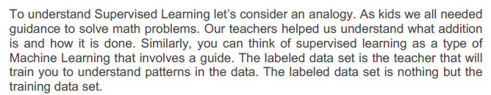

Slide 19
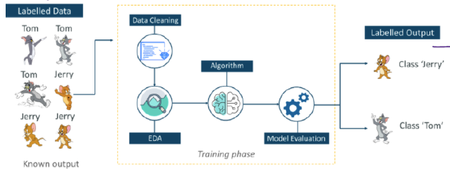
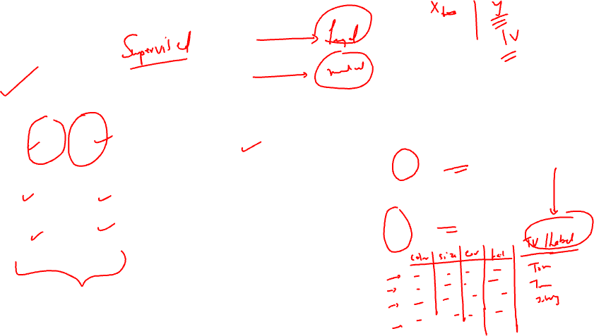

Slide 20
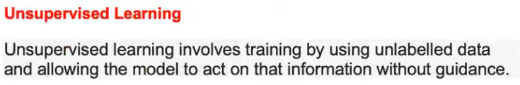
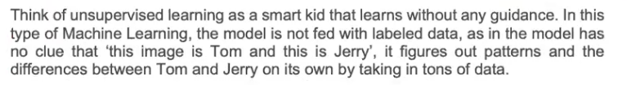

Slide 21
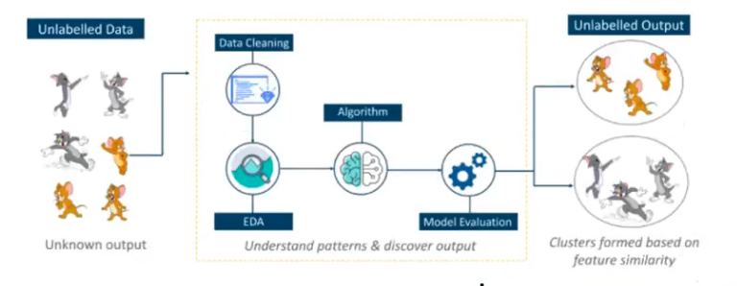
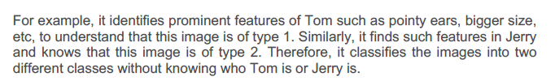
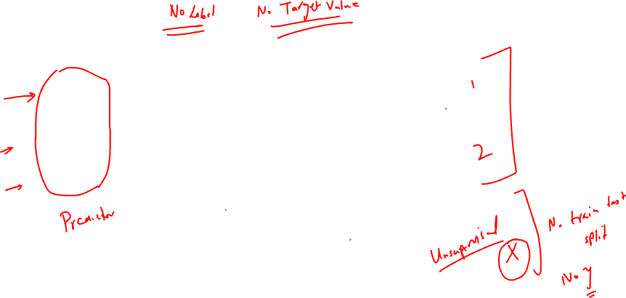

Slide 22
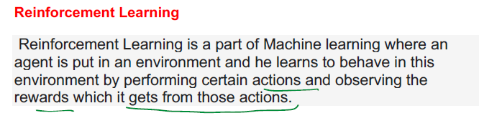
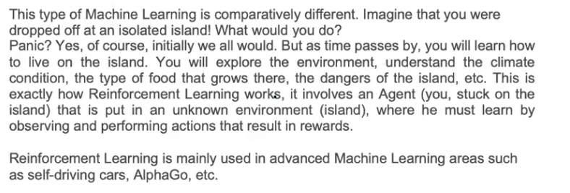
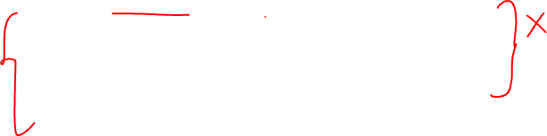

Slide 23
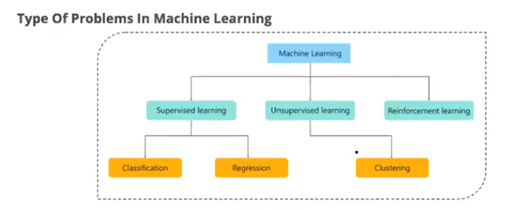
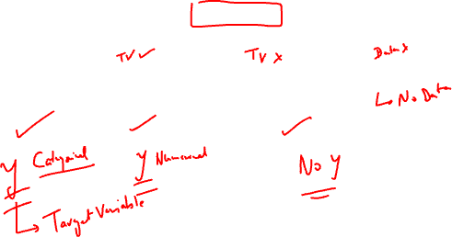

Slide 24
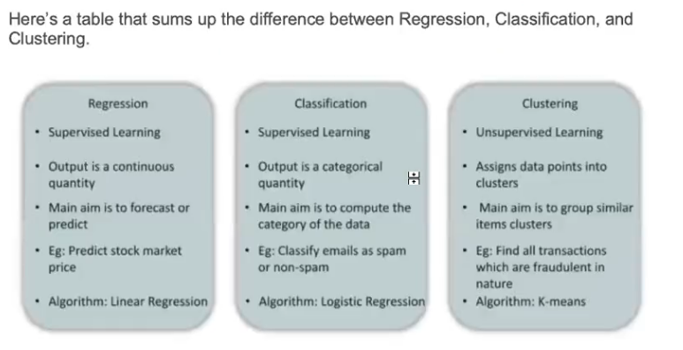
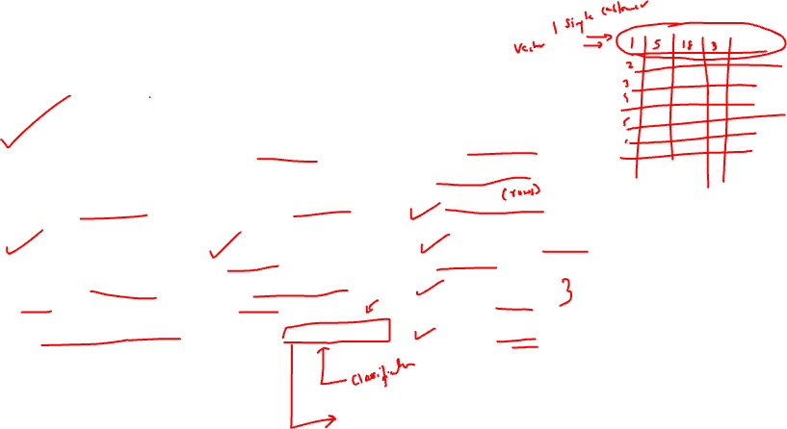

Slide 25
